Slide 1
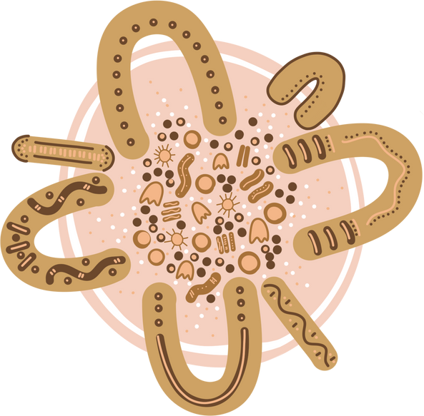
INDG6002 Health and Indigenous Peoples
Module 5 Tutorial:
Decolonising your practice

Slide 2

Warning
This presentation may include images, voices, stories, and names of deceased people now resting in the Dreaming that may cause sadness or distress to Aboriginal and Torres Strait Islander students.

Slide 3
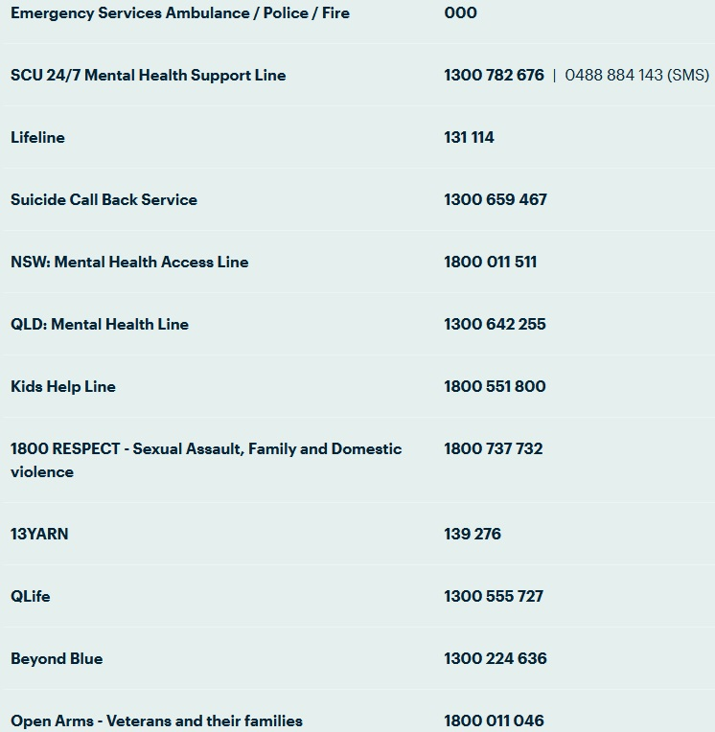
Warning
During this module we will be discussing discriminatory events and perceptions that may be triggering to some students due to lived experience. If you ever feel the need to take a break during one of these discussions on reading content, either for a short time or for the rest of the class session, you may always do so without academic penalty.
If students wish to discuss your personal reactions to this material, either with the class or with the Lecturer afterwards, such discussion is welcomed as an appropriate part of our coursework.
SCU help guide: https://www.scu.edu.au/current-students/services-and-support/counselling/after-hours-and-crisis-support/

Slide 4
Module 5
By the end of this module, you will be able to:
define and discuss what ‘Decolonising your practice’ means in the context of working with Indigenous Australians
further expand and deepen your understanding of the relationship between colonisation and the health and wellbeing of Australia’s Indigenous Peoples
begin to reflect on how you can decolonise your own thinking and practice when working with Indigenous clients in all service and support environments.

Slide 5
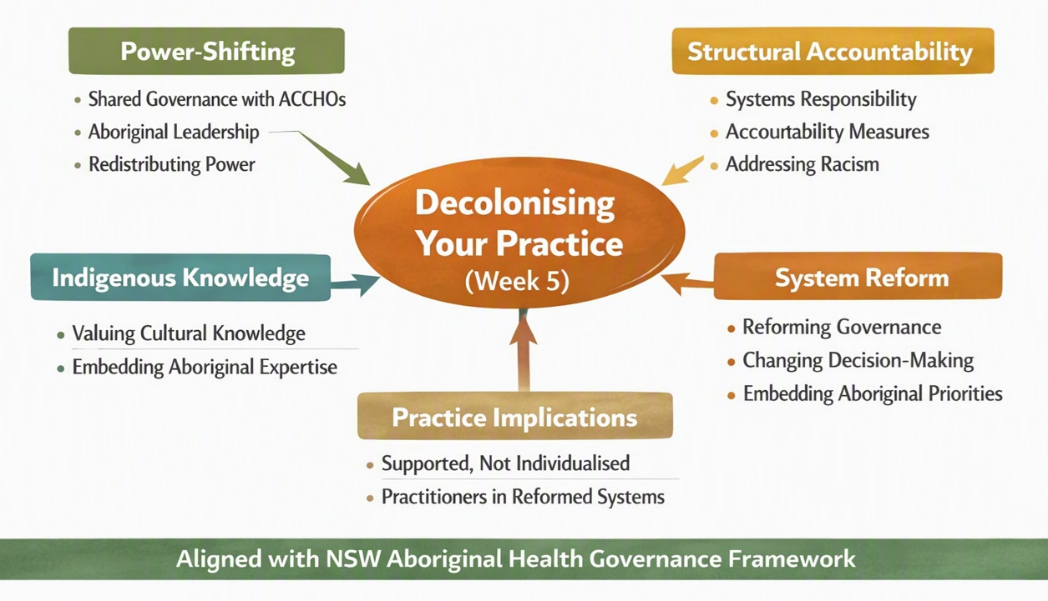
Mapping Module to grass-roots, community-led Indigenous frameworks and approaches
The NSW Aboriginal Health Governance, Shared Decision Making and Accountability Framework (2024)

Slide 6
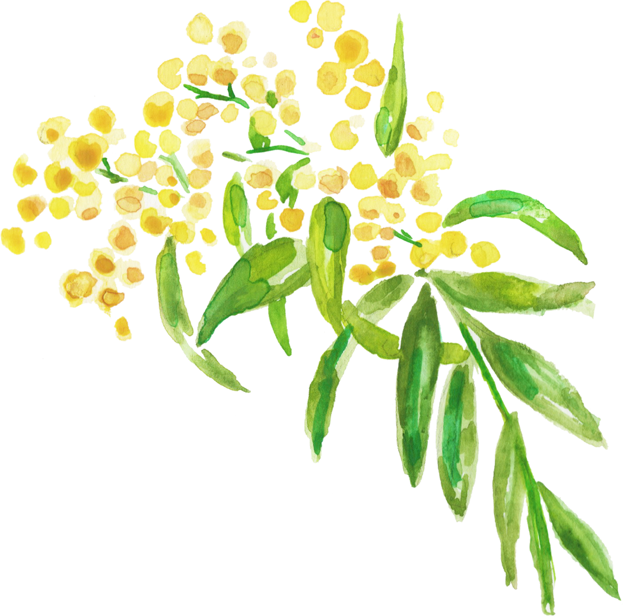
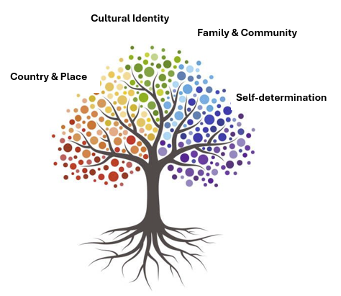
Recap: Strengths-based approach
A strengths-based approach is based on the premise that inherent strengths and resilience can be unlocked with structured support.
This approach recognises that individuals live within families, communities, and a culture that also have strengths and resources that will contribute to wellbeing
Focuses on abilities, knowledge and capacities -- empowering them -- rather than focusing on what people do not know or cannot do. …

Slide 7
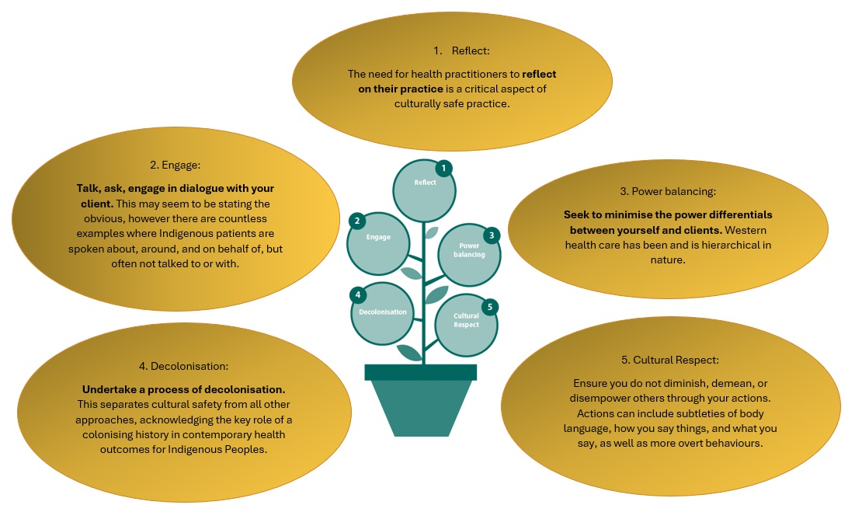
Recap - 5 Cultural Safety Principles
Reflexive Practice
Engage
Power Balancing
Decolonisation
Cultural Respect

Slide 8
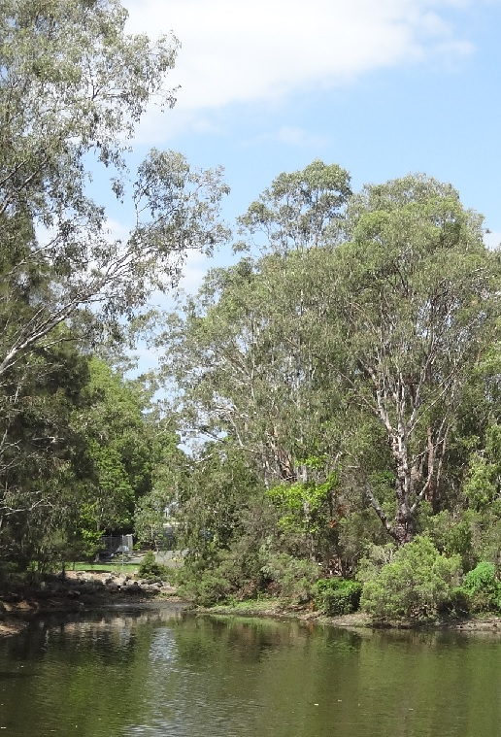
Dadirri
The word, concept and spiritual practice that is Dadirri (da-did-ee) is from the Ngan'gikurunggurr and Ngen'giwumirri languages of the Aboriginal Peoples of the Daly River region (Northern Territory, Australia).
Inner, deep, listening – “watching and listening, waiting, and then acting”
“Our Aboriginal culture has taught us to be still and to wait. We do not try to hurry things up”
Permission to use Dadirri can be sought from Miriam-Rose Ungunmerr https://www.miriamrosefoundation.org.au/dadirri/

Slide 9
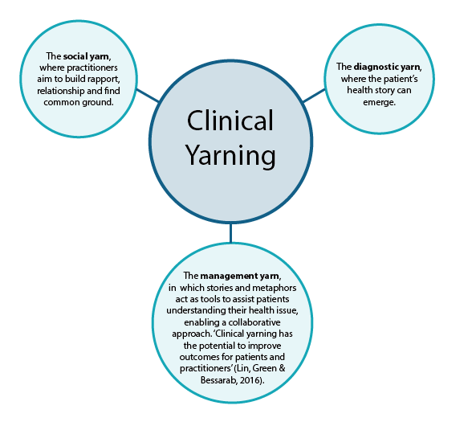

Yarning – thinking about a health setting

Slide 10

What affects communication – positive and negative ?
Who in the room can affect communication
Who is the expert in the room and who is important to listen to?
Are there competing agendas in health care?
Patient
Doctor/ Nurse
Medical Centre/ AMS
Government
Understanding Communication in a Health Context

Slide 11
It is important to:
Acknowledge the importance of engagement and the fact that the engagement process starts well before the actual Yarn
Consider the setting of the Yarn, and what might work best for the patient
Determine how you can best establish rapport and engage with the patient/client and their family
Consider the issue of confidentiality, and what this means in an Aboriginal and/or Torres Strait Islander community
Continued…

Slide 12
It is important to:
continued…
Understand the importance of cultural safety
Be respectful
Acknowledge your own limitations and the things we do not know
Develop a trusting relationship with the health workers and the community
Be mindful of your attitude, behaviour, and communication - at all times.

Slide 13
Understanding the difference between Relationships & Partnerships
Concept | Relationship | Partnership
Primary nature | Relational, cultural, lived | Structural, organisational
Duration | Lifelong or long-term | Often time-limited or project-based
Core principle | Reciprocity, respect, trust | Shared goals/tasks
Authority | Determined by community | Determined through agreements
Obligations | Ethical and cultural | Contractual or strategic
Can it exist alone? | Yes | No — must be built on relationship
Risk if done poorly | Disrespect, cultural harm
In Indigenous worldviews, relationship is the base layer of all ethical interaction. Without relationship, no collaboration can be culturally safe. Relationship comes first, always.
In Indigenous contexts - A partnership must follow a relationship, not replace it.

Slide 14

6 Stages of Decolonisation
Not an Indigenous issue –
  Responsibility lies with all Australians.
Structural change needs personal change –
  Challenge internalised myths and colonial ideologies.
  Requires honest self-reflection and commitment.
Six stages of decolonisation –
  Integrated, not linear.
  People move between stages, sometimes overlapping.
Muller 2022, pp 47-48
1. Rediscovery & Recovery
  Reconnect with history, language, Country, and kin. Renew identity and traditional knowledge.
2. Mourning
  Express anger and injustice. Begin healing; avoid getting stuck in this phase.
3. Healing & Forgiveness
  Focus on wellbeing and harmony, self-care, reflection, cultural renewal.
4. Dreaming
  Strengthen philosophy and knowledge.
  Build vision for recovery; draw on ancient and contemporary wisdom.
5. Commitment
  Choose a direction for action.
  Personal resolve toward change.
6. Action
  Proactive, positive steps.
  Not reactive or punitive—create meaningful change.

Slide 15
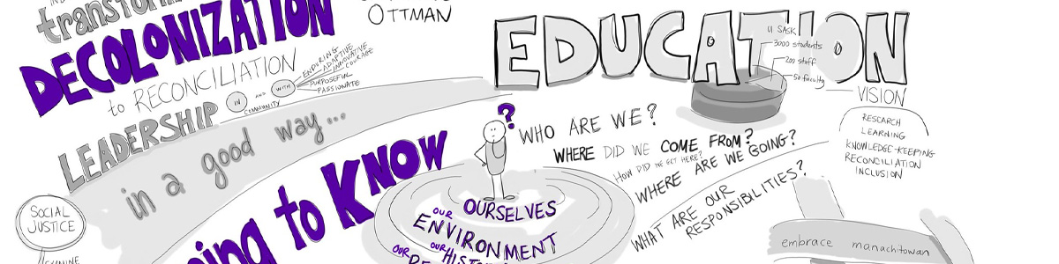
The future of social work in Australia relies on dismantling colonial structures and rethinking professional practice.
Decolonising means recognising that inequity stems from colonialism, not Indigenous peoples, and requires health and social care workers to challenge the dominance of Western culture.
By embracing cultural safety and valuing Indigenous ways of knowing, professionals can help redress systemic imbalances and foster more equitable relationships. Walter, M., & Baltra-Ulloa, A. (2019). Decolonising social work: Indigenous perspectives and practices

Slide 16
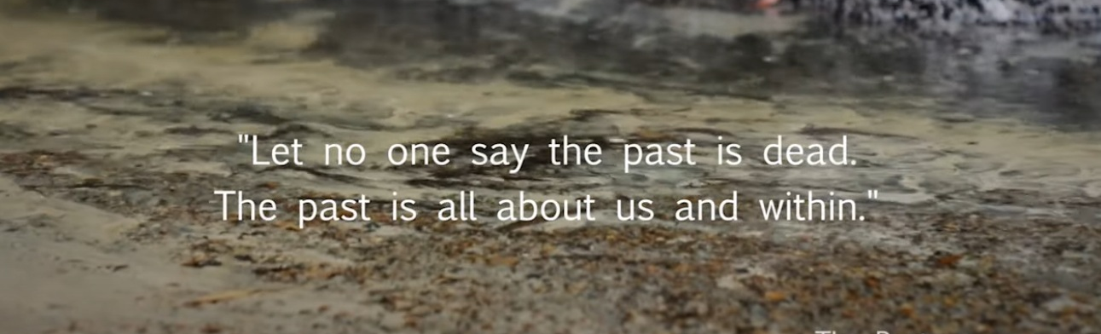
There is significant evidence confirming that Aboriginal Torres Strait Islander Peoples health continues to be a major challenge to governments, its agencies, health professionals and their communities
It is a statistical fact that Aboriginal and Torres Strait Islander Peoples are the poorest, unhealthiest, less employed, worse housed and most imprisoned Australians, but only half the community believes Aboriginal people are worse off than other Australians (only around 30 per cent believe they are ‘a lot’ worse off), then there is a significant gap between the facts and what many believe about the position of Aboriginal and Torres Strait Islander Peoples (Newspoll survey 2000 cited in Behrendt 2003: 65)
We believe the critical issues that underlie the lack of improvement in Aboriginal and Torres Strait Islander peoples health are the continuation of colonisation, through the dominance of western worldviews in research, policy, planning, and praxis; the lack of Indigenous health models and the dominance of the bio-medical model; and everyday personal and institutional racism.
(Sherwood & Edwards 2006, pp. 182-3)
Why decolonisation is critical

Slide 17

Decolonisation
“Decolonisation is like a tapestry; our culture is like a tapestry with big bloody stab holes in it and what we’ve gotta do is repair that. We will probably never get the same thread, but it will be ours and something we can own and use to move forward
We can’t do it alone!
(Dowling, in Taylor, 2017)

Slide 18
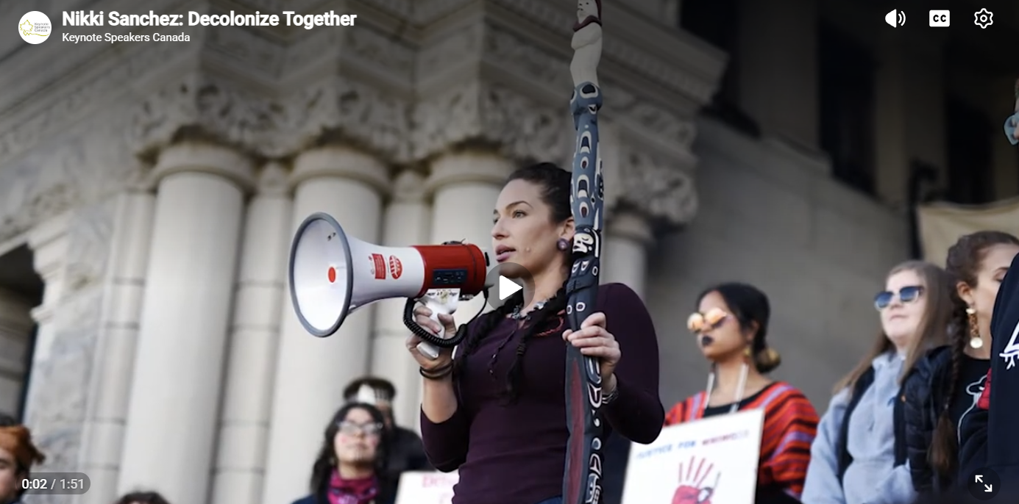

Slide 19
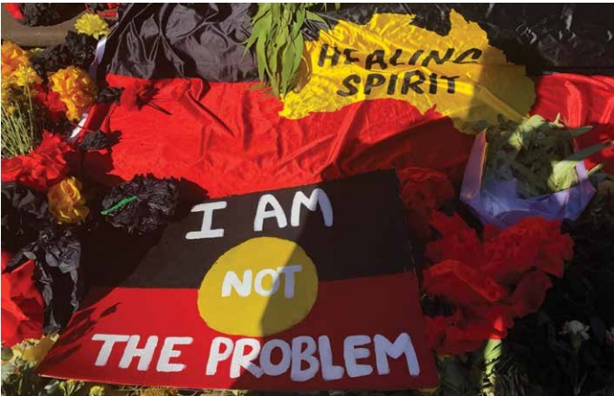
Decolonisation is …
… the process of dismantling and reversing the impacts of colonisation, not just the structures but the institutions and the ways of thinking of the colonists.
… deconstructs the various ways in which ethnic and racial minority communities are presented as problematic and often blamed for their own misfortunes
… the process of proactively shifting the focus of worldviews and ideologies; reclaiming Aboriginal and Torres Strait Islander ways of knowing, being, and doing that were/are considered inferior by colonial processes.

Slide 20
Cultural safety is a tool to dismantle and unsettle the dominant ways of thinking about health and social care.
A decolonising of your practice inevitably includes the examination of the omnipresent existence of race that exists in human relationships
(Walter & Baltra-Ulloa, 2019)
How might decolonising your practice look and feel?

Slide 21
The Yarrabah Health and Wellbeing Model
What Happened:
Yarrabah community created its own health service.
Indigenous leaders took control of governance and service design.
Gurriny Yealamucka Health Service became the main provider of primary care.
Staff are mostly local Aboriginal workers.
Programs include cultural camps, youth leadership, healing circles, and chronic disease support.
Health promotion is delivered through relationships, culture, and community events.
Why It Matters:
Decolonisation: Shifts power from colonial systems to Indigenous governance.
Strengths‑based practice: Focuses on culture, resilience, identity, and community strengths.
Cultural safety: Care is respectful, relational, and grounded in Indigenous worldviews.
Self‑determination: Community decides how health services operate.
Structural change: New funding models, new workforce structures, new ways of delivering care.
Positive wellbeing outcomes: Increased trust, better access, stronger identity, healthier community.

Slide 22
Decolonisation – Steps to take
Be specific about Nations Name the exact Country, Nation, or language group. Avoid broad terms unless discussing pan‑Indigenous issues.
Use community‑preferred names Follow the spelling, terms, and language used by local Elders and knowledge holders.
Focus on strengths, not stereotypes Highlight resilience, innovation, and deep knowledge traditions — not deficit narratives.
Recognise Indigenous knowledges as knowledge systems They are complex, relational, place‑based, intellectual — not myths or “add‑ons”.
Acknowledge cultures as living Indigenous cultures continue to grow, adapt, and thrive today.
Use respectful language Shift from “they believe…” to “In Noongar knowledge systems…” or “According to Bundjalung Elders…”.
Learn the full history Understand colonisation, dispossession, resistance, and ongoing impacts without minimising harm.
Know your own position Be aware of how your identity and background shape the way you learn and speak about Indigenous knowledges.
Prioritise Indigenous voices Use materials, teachings, and stories from Indigenous people. Do not speak for communities.
Avoid generalising There are hundreds of Nations — always identify whose knowledge you’re referring to.
Include Indigenous perspectives regularly Indigenous content should appear across subjects, not as a one‑off topic.
Think in terms of relationships Indigenous knowledges are connected to Country, kinship, community, and responsibility.
Balance truth with strength Learn about colonial impacts alongside survival, creativity, and ongoing cultural strength.
Stay humble It’s okay not to know — be open to learning, listening, and being corrected.

Slide 23
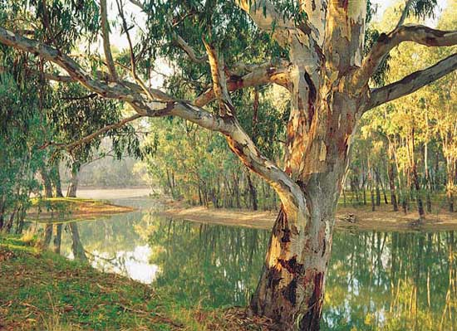
Activity: Decolonising your practice
Decolonising practice means:
the problem is systems, not Indigenous peoples
health workers have power
listening and respect are important
Learning to unlearn is about listening deeply, letting go of control, and being humble in relationships
(Walter & Baltra-Ulloa, 2019)
Decolonising practice asks health workers to unlearn dominant ways of thinking and to centre respectful relationships

Slide 24

AIATSIS - Core cultural learning
Core cultural learning | AIATSIS
Why should I do it?
Core provides a detailed exploration of Aboriginal and Torres Strait Islander peoples and situations, as a means of assisting you to enhance your cultural understanding; gain a deeper sense of self-awareness and critical reflection; and enhance your personal and professional capacity to engage respectfully and effectively in an intercultural context.
The program is designed to encourage people to understand their own cultural perspectives as the basis for effective interactions with people of (other) diverse backgrounds.

Slide 25
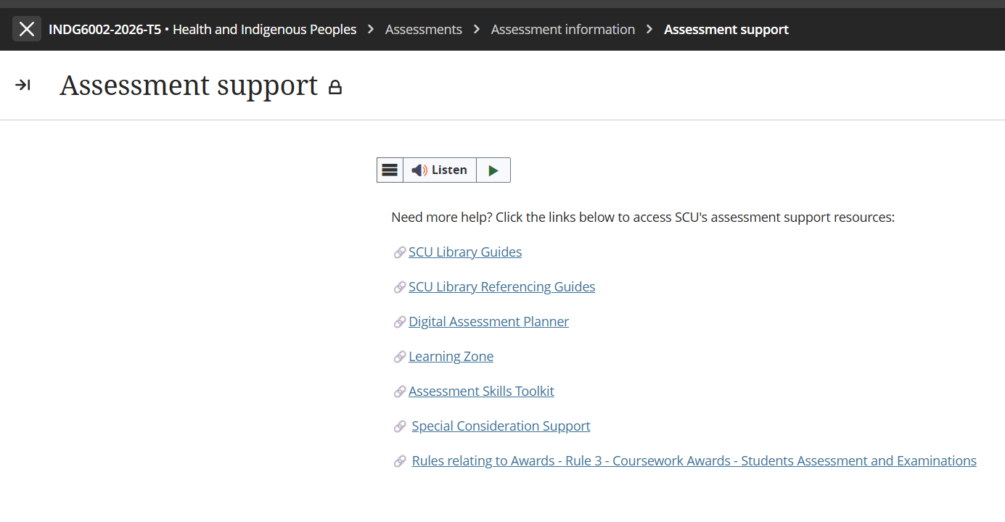
Special Considerations Support Extension

Slide 26
Assessment 2 – Critical Review
Title | Assessment 2
Type | Critical Review
Length | 2,200 words
Weighting | 60%
Academic Integrity | Level 2. Purpose-Specific GenAI Use GenAI may NOT be used EXCEPT Grammarly Premium AI.
Submission | Word document submitted to Blackboard
Unit Learning Outcomes | This assessment task maps to the following ULOs: 1. Discuss key concepts of health and wellbeing as determined by Aboriginal people 2. Identify key stages of the colonisation process and its relationship to the contemporary health status of Australian Indigenous people 3. Analyse the relationship between socio-economic factors and the contemporary health status of Australian Indigenous people 4. Explain how primary health care and/or health promotion enhances the wellbeing of Indigenous people and role of the health professional as an agent of social change

Slide 27
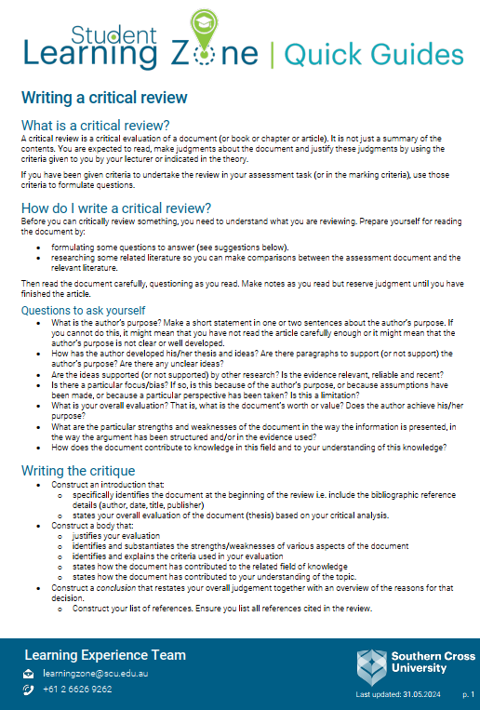
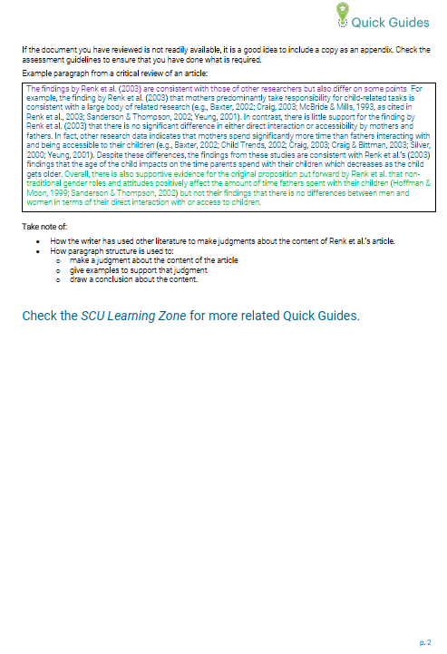
Writing a Critical Review
https://www.scu.edu.au/media/scu-dep/current-students/learning-zone/quick-guides/writing_a_critical_review.pdf

Slide 28
Critical Review of the Scenario
A critical review goes beyond description by examining why something happened, how it influences outcomes, and what it means in a broader context
In this assessment, you are not reviewing a written document—you are critically reviewing a scenario and practice interaction.
Instead of reading an article, you are examining:
  Sarah’s experiences
  The impacts of colonisation on her contemporary health
  the cultural context shaping the encounter
  the power dynamics in the consultation
  How primary health care and health promotion can respond

Slide 29
Critical Review of the Scenario
Judge the strengths and weaknesses (of the actions and recommendations in the scenario) – which must be evidence-based
Identify bias or assumptions - Analyse privilege, whiteness, and Western norms (how these assumptions affect Sarah’s wellbeing and care)
Overall evaluation - Judgement about the quality of practice - Must be linked to theory
A critical review always ends with a judgement.

Slide 30
Assessment 2 - Brief
Rationale – Why this assessment matters
Apply unit concepts to a realistic health care scenario
Critically examine culturally safe, strengths‑based, socially responsive practice
Analyse:
  SEWB concepts
  Impacts of colonisation
  Socioeconomic determinants
  Primary health care & health promotion
Shift away from deficit views → recognise strengths, resilience, cultural connections, self‑determination
Understand health professionals as agents of social change
Explore how culturally safe, equitable care supports Indigenous wellbeing
Assessment Task – What students must do
Write a critical review of the Sarah scenario
Examine how health professionals and services can support Indigenous health and wellbeing
Apply unit concepts to Sarah’s experiences and the clinic’s service improvements
Analyse culturally safe, strengths‑based approaches using scholarly evidence (min. 12 sources)
Evaluate the quality of practice → identify strengths, weaknesses, bias, assumptions
Provide evidence‑based recommendations for culturally safe care and SEWB‑aligned practice
Link all analysis to theory: SEWB, cultural safety, colonisation, determinants, PHC, health promotion

Slide 31
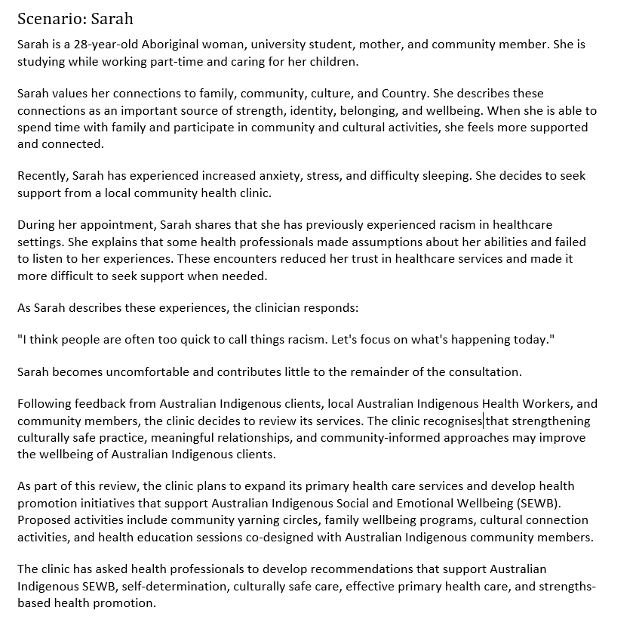
Assessment 2 Scenario

Slide 32
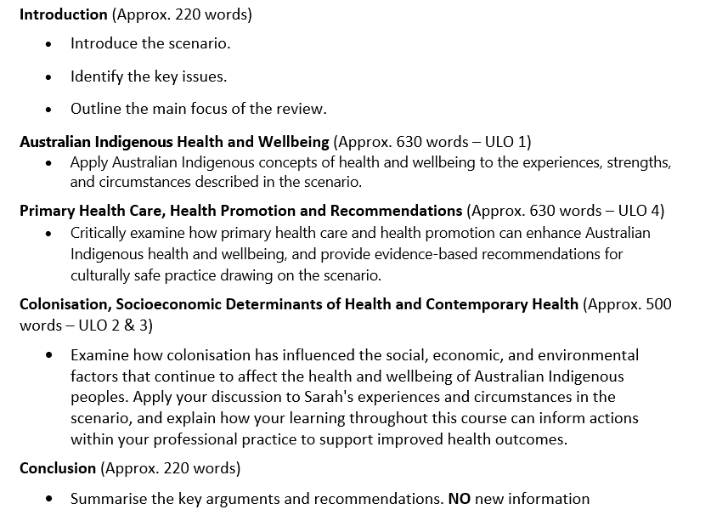
Example Assessment Structure

Slide 33
Your response must …
Assessment Requirements
Be written in a clear, coherent, and respectful academic style.
Support your discussion with evidence from:
  Scholarly literature
  Unit materials
  Definition of Scholarly and Peer-Reviewed sources
  Peer-reviewed sources are academic publications that have been evaluated by experts before publication to ensure quality, accuracy, and credibility. Scholarly sources are written by researchers or experts for an academic audience and include journal articles, academic books, conference papers, and theses. They typically provide author credentials and references. All peer-reviewed sources are scholarly, but not all scholarly sources are peer-reviewed. For example, an academic book may be scholarly without undergoing peer review.
Utilise evidence from a minimum of 12 scholarly sources to support your analysis
Use correct terminology and tone when referring to Australian Indigenous people
Use APA 7th document, referencing, and citation styles in this Unit
Label your submission with your surname and initials, and the assessment task's name, for example:
SmithJ_Critical Review.docx
You MUST add a footer to your submission.
Add your name and task type – i.e. SmithJ_CriticalReview on left margin, your student ID, and have page number on the right margin. See the example below:

Slide 34
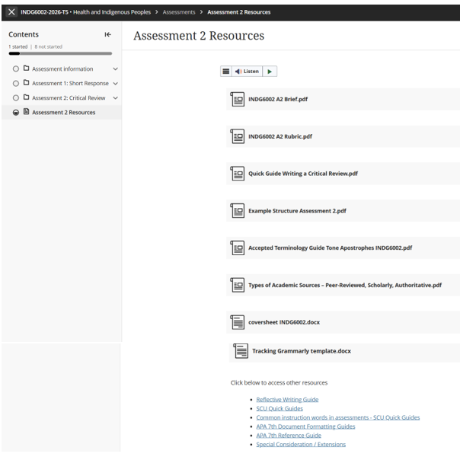
Task Resources & Other Requirements

Slide 35
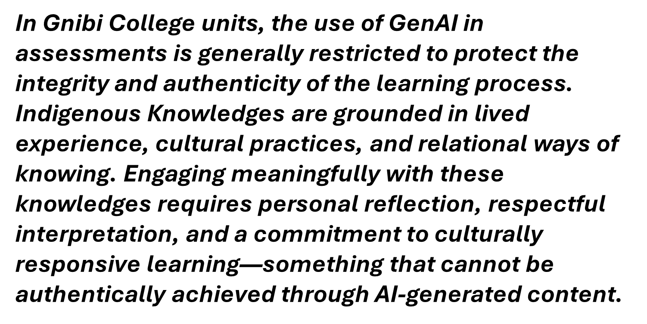
INDG6002 GenAI Use

Slide 36
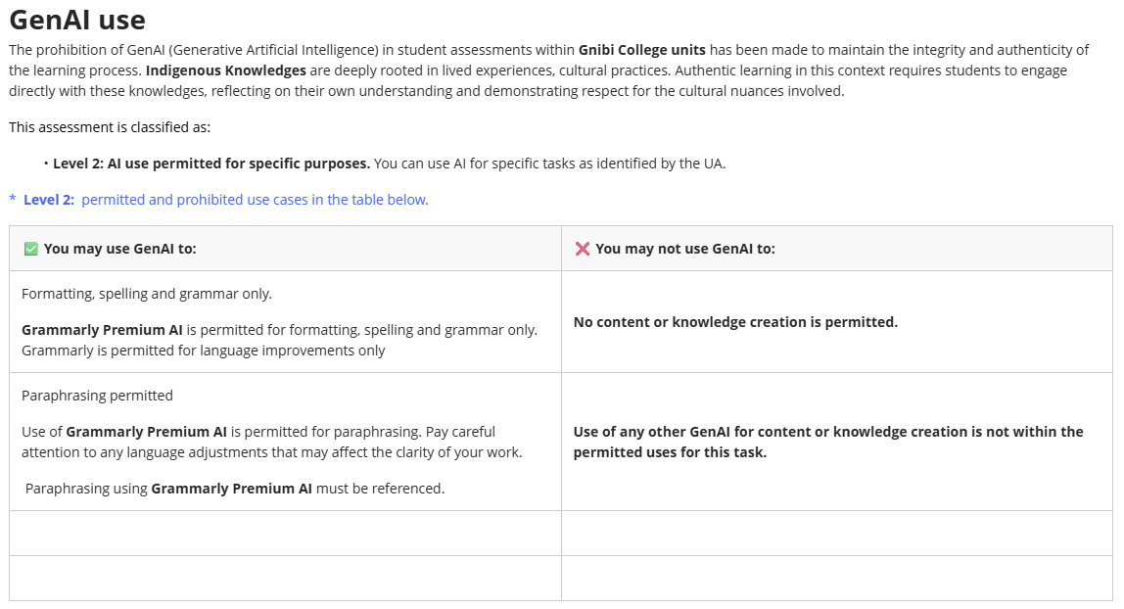
GenAI Use continued …

Slide 37
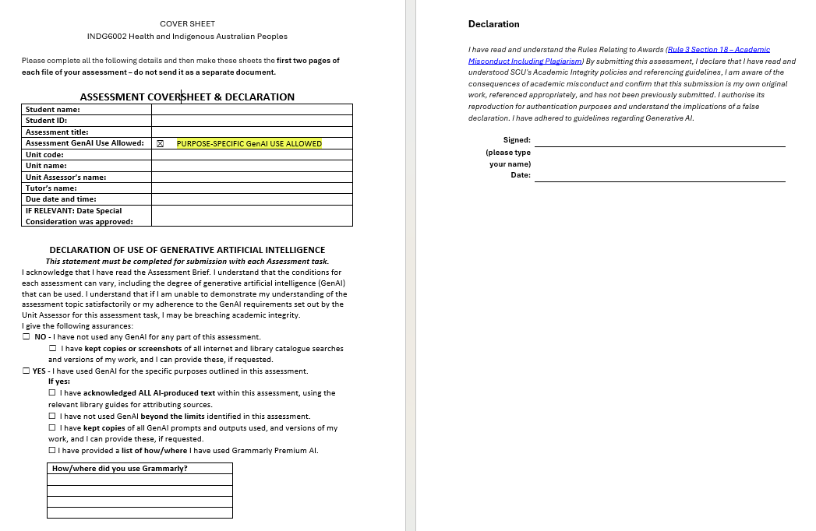
Coversheet & Declaration

Slide 38
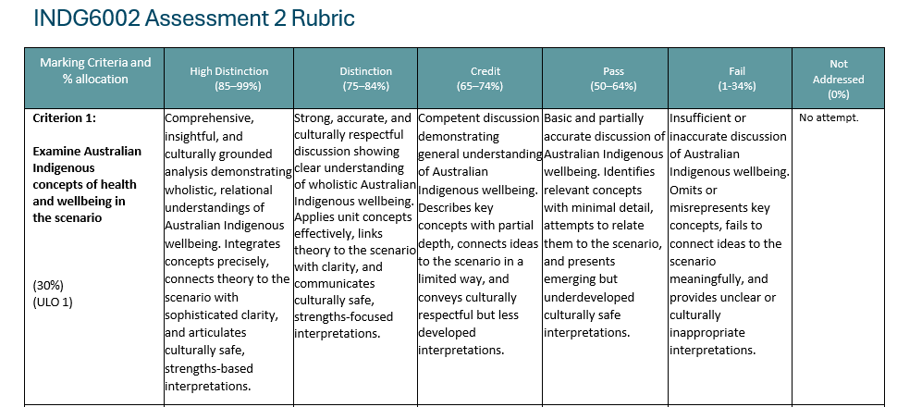
Assessment 2 - Rubric

Slide 39
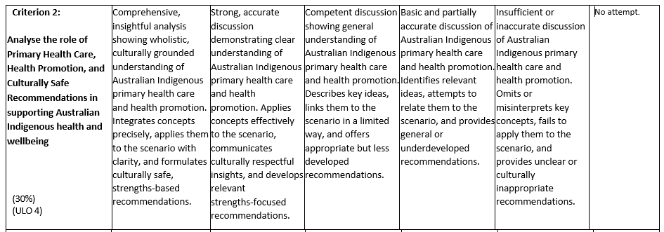
Assessment 2 - Rubric

Slide 40
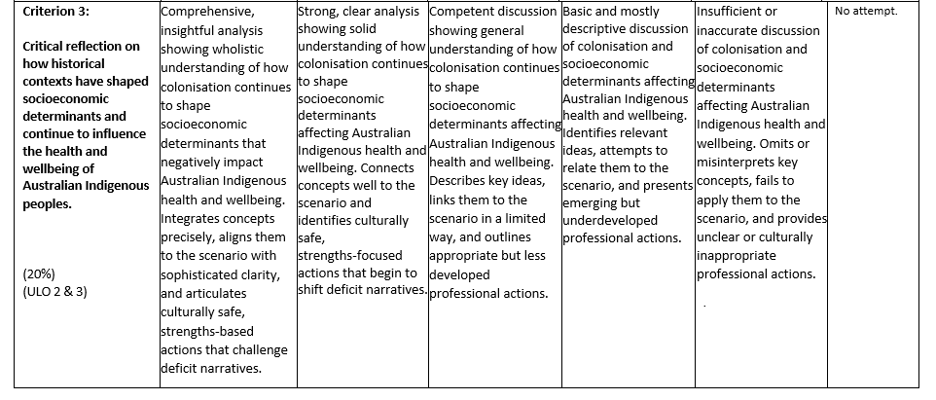
Assessment 2 - Rubric

Slide 41
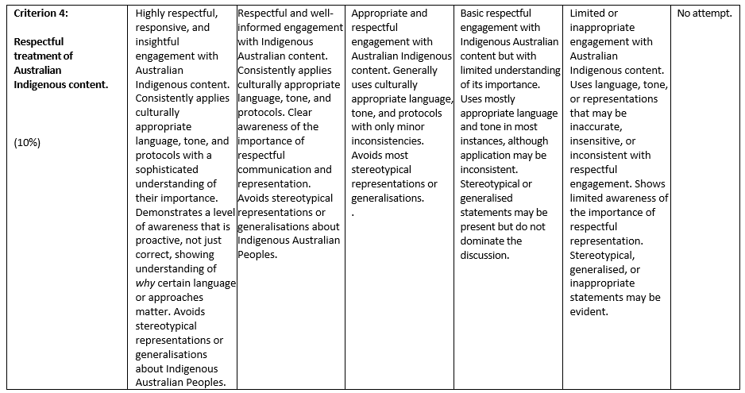
Assessment 2 - Rubric

Slide 42
Questions?

Slide 43

Next week

